Slide 1
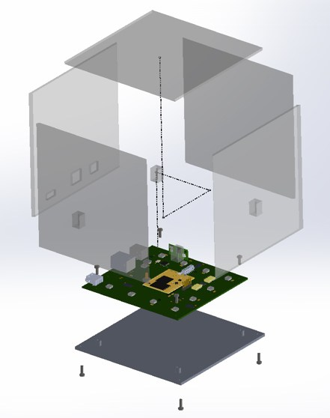
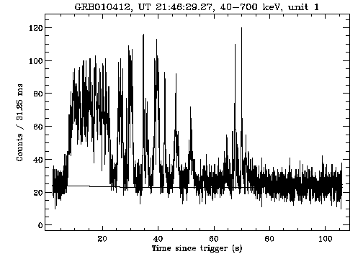
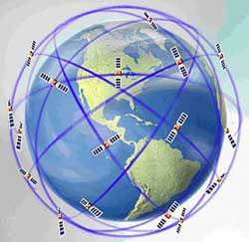
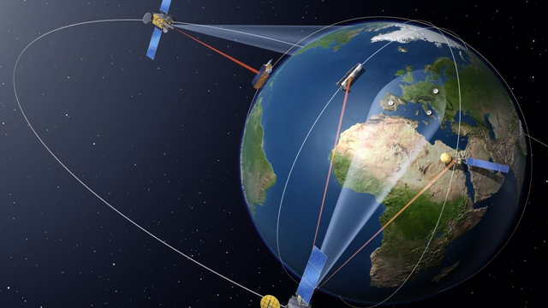
The HERMES mission High Energy Rapid Modular Experiment Satellites (a nanosatellite swarm monitor for GRB & High Energy GW counterparts)
GRB statistics
Average GRBs: 300/yr
Bright GRBs: 30/yr
GRB structure: duration 25 s, shot noise τ = 1 ms, rate = 100/s
Instrument
N ≥ 100 Nano Satellites (Modules) in Low Earth Orbit
Average separation between Modules: 6000 km
Module (weight ≤ 10 kg)
5 Detectors
Field of View of each Detector: 2 steradians
GPS absolute temporal accuracy ≤ 100 nanoseconds
GPS based Module positional accuracy: ≤ 10 m
Detector
Scintillator Crystals: CsI (classic) or LaBr₃ or CeBr₃ (rise − decay: 0.5 − 20 ns)
Photo-detector: Silicon Photo Multiplier (SiPM) or Silicon Drift Detector (SDD)
Effective area: 10 × 10 cm
Weight: 0.5/1 kg
Energy band: 3 keV − 50 MeV
Energy resolution: 15% at 30 keV
Temporal resolution: ≤ 10 nanoseconds
Mission performance
Accuracy in delays between Average GRB lightcurves of two Modules
(cross correlation techniques): 20 microseconds for Average GRBs
Continuous recording of buffered data
Triggered to ground telemetry transmission
Accuracy in positioning of Average GRB: 6 arcsec
Accuracy in positioning of Bright GRBs: 0.5 arcsec
Modular structure: overall effective area 1 m² every 100 modules
Scintillator Crystal
detector
courtesy of
F. Frontera
electronics
solar panel

